Slide 1




Data-Juicer: A One-Stop Data Processing System for Large Language Models
Tongyi
Daoyuan Chen, Yilun Huang, Zhijian Ma, Hesen Chen, Xuchen Pan, Ce Ge, Dawei Gao, Yuexiang Xie, Zhaoyang Liu, Jinyang Gao, Yaliang Li, Bolin Ding, Jingren Zhou
Tongyi Lab, Alibaba Group
2024/06/12
GitHub: https://github.com/modelscope/data-juicer
Notes:
Hi everyone! I’m Yilun Huang from the Tongyi Lab, Alibaba Group. I’m very excited to have this opportunity to introduce our work here during SIGMOD 2024, which is Data-Juicer: A One-Stop Data Processing System for Large Language Models.

Slide 2
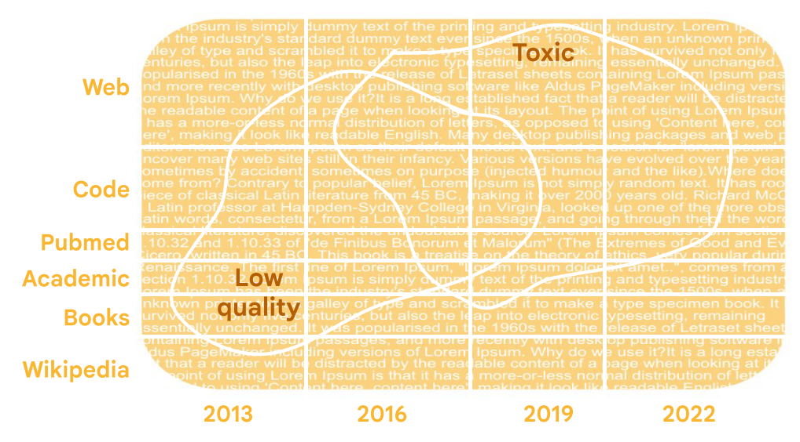
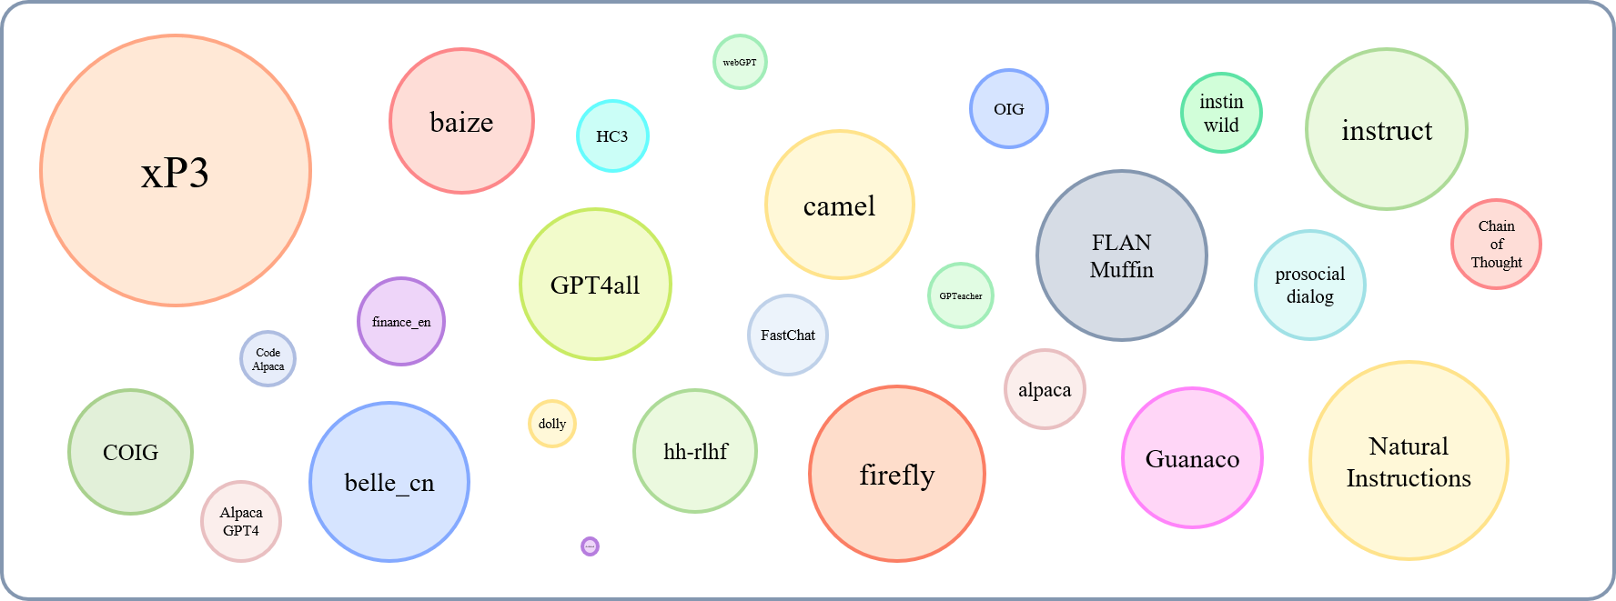
From Data to LLMs
Different types of data from diverse sources
High heterogeneity in training data
Data Recipe: how to process & mix datasets
Initial LLM 1
Tens of Recipes
Pretraining
Web, Wikipedia, Academic, ……
Garbage in,
garbage out
Pretrained LLM 1
Tens of Recipes
Finetuning
Instruction, Chat, ……
Finetuned LLM 1
Data recipe
[1] ﻿A Pretrainer’s Guide to Training Data: Measuring the Effects of Data Age, Domain Coverage, Quality, & Toxicity
[2] An Empirical Study of Instruction-tuning Large Language Models in Chinese
Notes:
LLMs are very popular now. As we know, training LLMs requires lots of datasets. As “garbage in, garbage out” suggests, data processing is one of the most important steps for training LLMs. But there are many challenges in converting lots of data to an excellent LLM.
First, different stages of training need different kinds of datasets, and they might come from different sources. So there are diverse data processing pipelines and recipes for these highly heterogeneous data.
Here we say data recipe, it usually represents a pipeline for how to process and mix input datasets. There could be high heterogeneity in these recipes as well, so nearly every LLM has its own recipes and pipelines and it’s hard to reuse and share for the community.

Slide 3



From Data to LLMs
Massive data volume
Complex data processing pipelines
High cost to retry and refine
Initial LLM 1
Tens of Recipes
Pretraining
Web, Wikipedia, Academic, ……
Pretrained LLM 1
TB Tokens
Tens of Recipes
Finetuning
Instruction, Chat, ……
Finetuned LLM 1
[1] ﻿A Pretrainer’s Guide to Training Data: Measuring the Effects of Data Age, Domain Coverage, Quality, & Toxicity
[2] An Empirical Study of Instruction-tuning Large Language Models in Chinese
Notes:
Besides, training and finetuning a LLM requires TB tokens of datasets, thousands of GPUs, several weeks, and most importantly, millions of dollars. And the data processing pipelines for such massive data volume are very complex. For most researchers, it’s hard to afford such high cost to retry and refine datasets for multiple times according to the true model performance, which makes it difficult to get really high-quality datasets for the final LLMs.

Slide 4
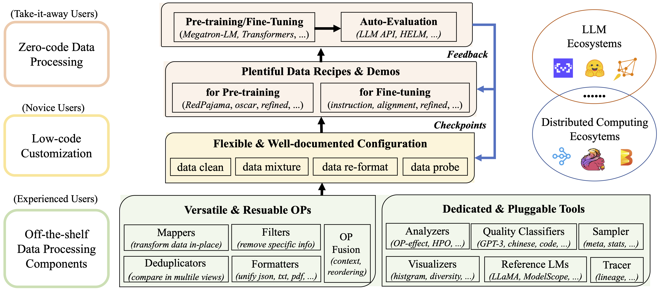
Data-Juicer: Overview
Systematic & Reusable
OPs, tools & data recipes
User-Friendly & Flexible
Zero/low-code, customizable
Comprehensive documents
Efficient & Robust
System performance optimization
OP Fusion
Distribution supported
Actionable & Measurable
Data-model co-development
Multiple feedback signals
Notes:
So we introduced Data-Juicer to meet these challenges. It has many nice features.
First of all, it’s systematic and reusable. Data-Juicer provides lots of operators, tools and data recipes in a unified form.
Second, Data-Juicer is flexible and user-friendly. Different users can develop data with Data-Juicer in different ways according to comprehensive documents.
Third, Data-Juicer is quite efficient and robust. We optimize the processing performance for the whole system in different aspects, including OP Fusion and distributed processing.
Finally, Data-Juicer allows data-modal co-development. During data processing, Data-Juicer would return multiple feedback signals to help users monitor the data effect on time, which makes the it actionable and measurable. Now, let’s dive into the details of Data-Juicer.

Slide 5
Data-Juicer: Standard OPs
Type | Num. | Description
Formatter | 7 | Discovers, loads, and canonicalizes source data
Mapper | 43 | Edits and transforms samples
Filter | 41 | Filters out low-quality samples
Deduplicator | 5 | Detects and removes duplicate samples
Selector | 2 | Selects top samples based on ranking
Standard Interface
Basic capabilities of data processing
Input: datasets
Output: processed datasets
Notes:
The first part is what are operators. Operators provide the basic capabilities for data processing in standard interfaces, such as removing unexpected characters, filtering out non-English texts, or deduplicating the datasets.
Now Data-Juicer contains 5 types, over 100 operators.

Slide 6
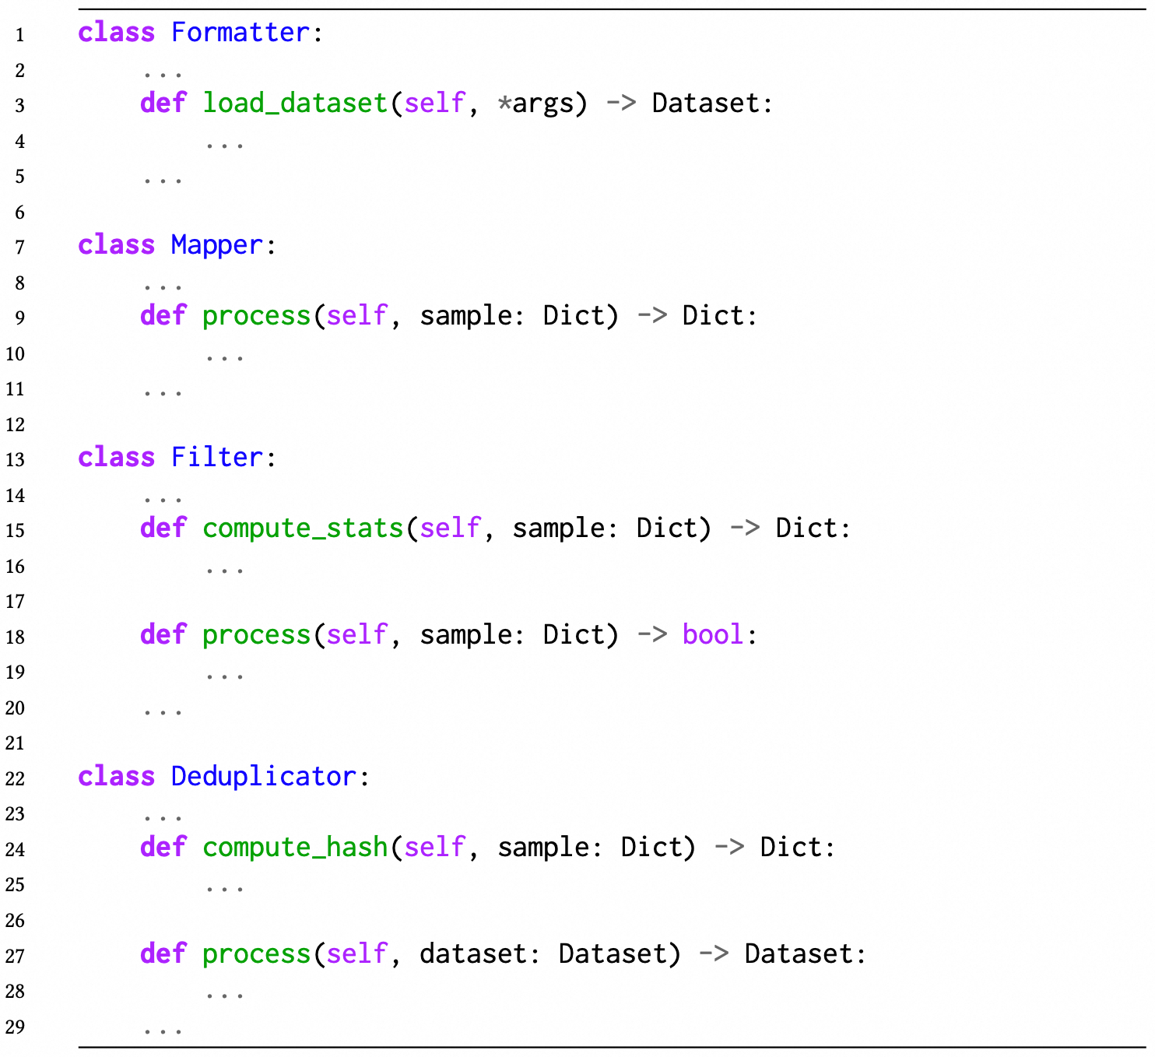
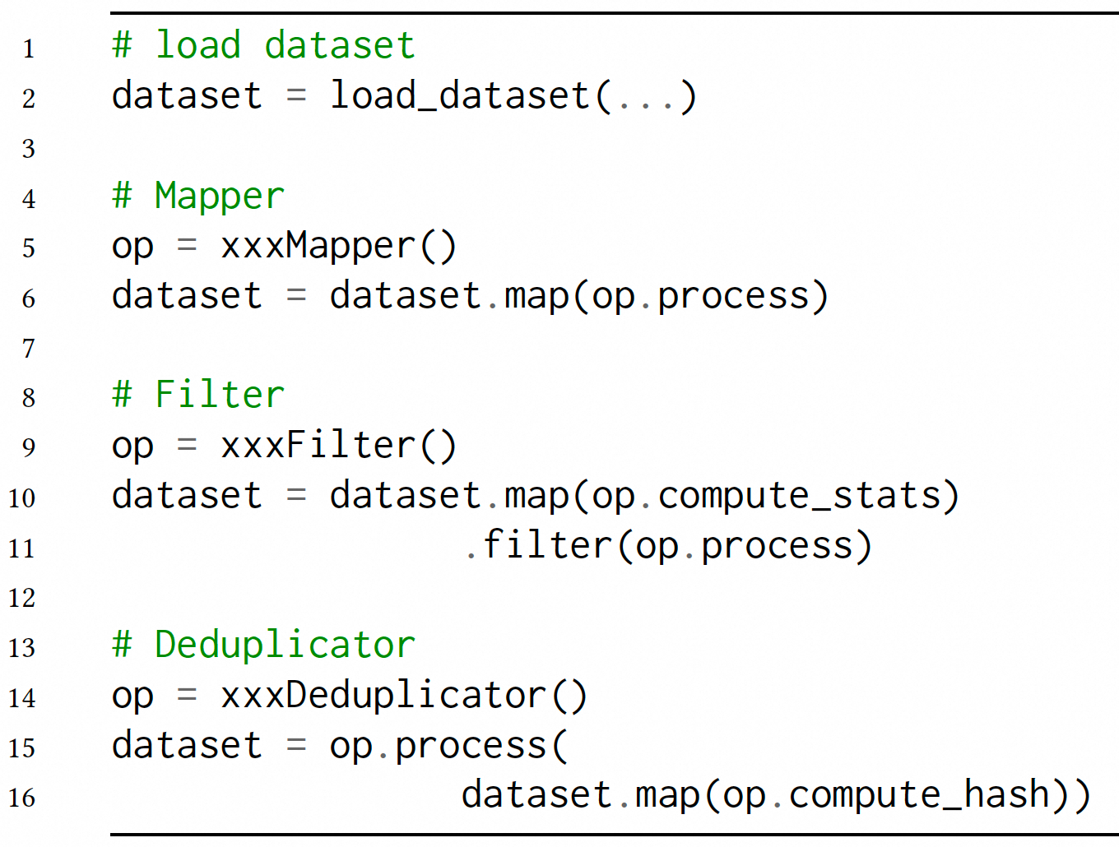
Data-Juicer: Standard OPs
Standard OP base class
Unified invoking logic
Notes:
Why we say these OPs are standard?
Data-Juicer provides standard and simple OP base classes. Users can easily implement their own OPs by inheriting from them.
For each type of OPs, their invoking logics are unified. For example, for Filter, we need to compute stats for each sample, then remove samples whose stats are unexpected.

Slide 7
Data-Juicer: Tools
Dedicated for complex and specific functions
Analysis
Processing trace
Visualization
……
Notes:
In addition to standard OPs, Data-Juicer provides lots of dedicated tools for some complex and specific functions.

Slide 8
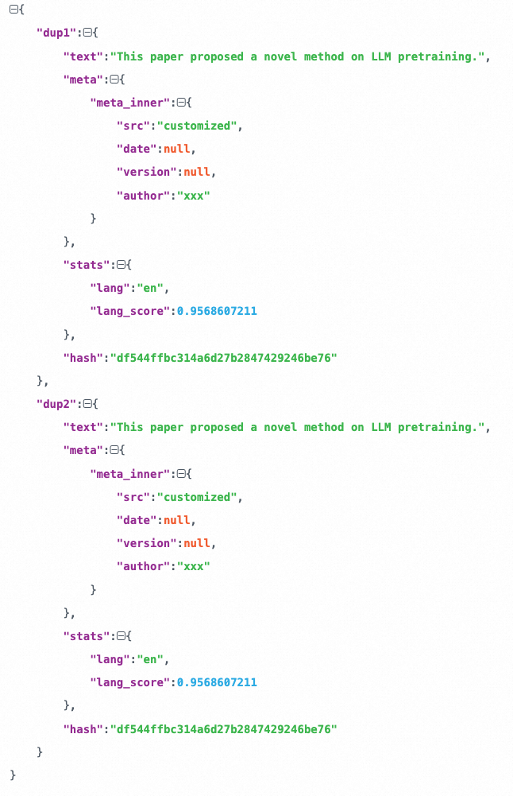
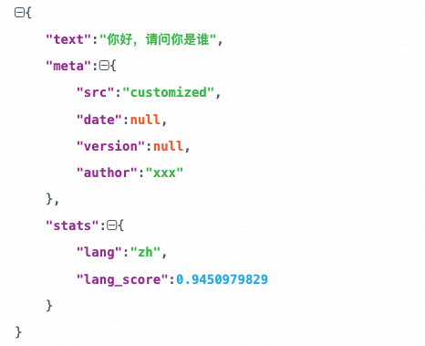
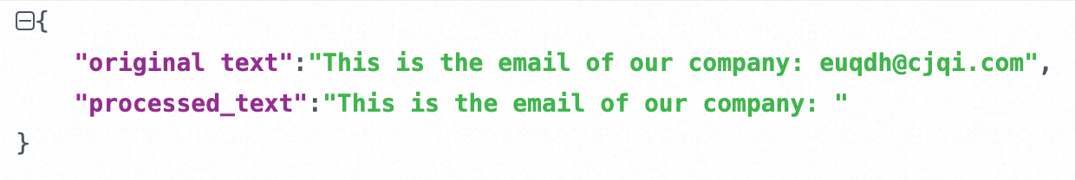
Tools: Tracer
Deduplicator: (near-)duplicate sample pairs
Sample-level changes before/after each OP
Filter: filtered-out samples
Mapper: modified samples
Notes:
For example, the tracer tool is used to trace sample-level changes before and after processed by each OP during the data processing.
For Filters, it would trace those filtered-out samples and their stats.
For Mappers, it would trace the modified samples.
And for Deduplicators, it finds out those duplicate or near-duplicate sample pairs along with their hash values. So it’s easy for users to know how each OP works intuitively.

Slide 9
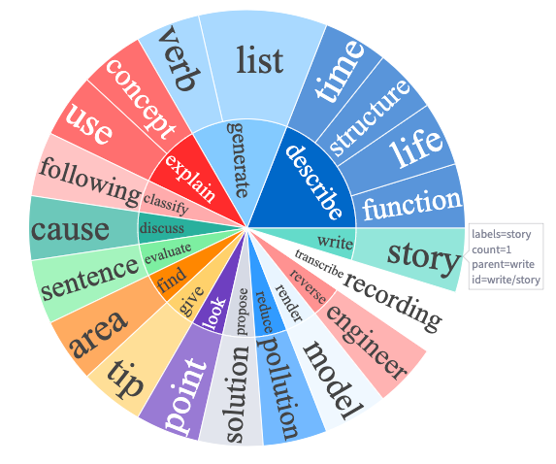
Tools: Analyzer
Quality: stats distribution
Character repetition ratio
Perplexity
......
Diversity: lexical combination
Notes:
Analyzer is also a core tool in Data-Juicer. It helps users to analyze the datasets from different aspects and output the analysis results.
For the quality of datasets, it computes the distributions of OP stats.
For the diversity of datasets, it mainly counts the frequencies of different lexical combinations for the whole datasets. And there are much more other useful toolkits.

Slide 10
Data-Juicer: Data Recipes
Data recipe includes:
Data source
Mixture proportions
Data processing pipeline
……
Effect-proven
Reusable and shared in the community
Initial LLM 1
Tens of Recipes
Web, Wikipedia, Academic, ……
Pretrained LLM 1
Tens of Recipes
Instruction, Chat, ……
Finetuned LLM 1
Notes:
With so many OPs and tools, we can construct the data processing pipelines as data recipes. Data recipes usually include information about data sources, their mixture proportions, processing pipelines and so on. They are effect-proven by researchers and can be reused and shared in the community.
And they can be used to refine the datasets for different stages of LLM training.

Slide 11
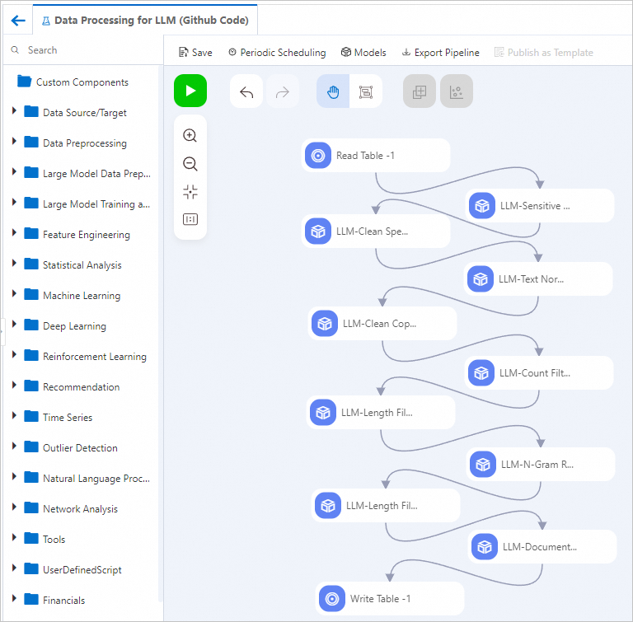
How to config for data recipes
Three ways to config:
A piece of code: describe the processing pipeline
A config file (recommended: simple & flexible)
Drag-drop interface: equivalent to a config file
Notes:
Data-Juicer uses a flexible and simple config module to config for data recipes. There are three ways to do this. We can write a piece of code in Python to describe the processing pipelines. Or a config file in YAML format, which is more recommended because it’s simple and flexible. Or we can config them with a drag and drop interface, and it’s just equivalent to the config file.

Slide 12
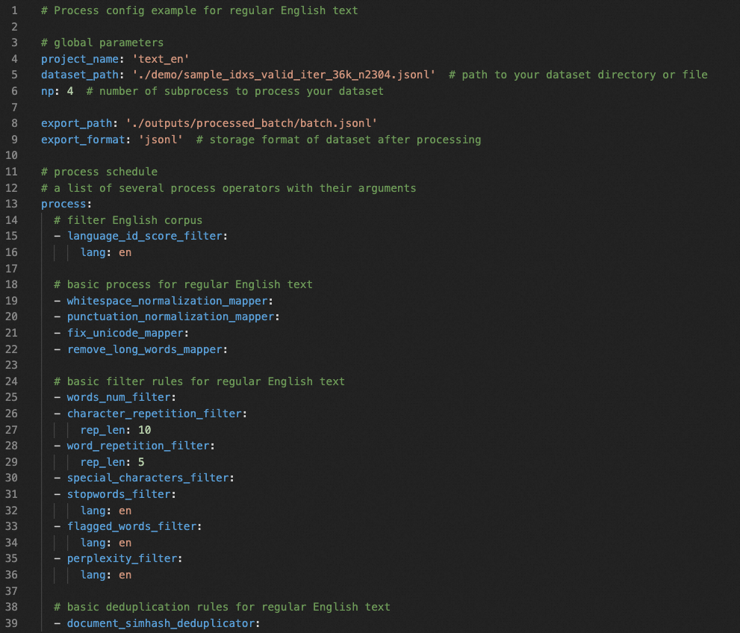
Example: A Config File for Data Recipe
Global Arguments:
Paths to: datasets, processed results, ……
Num of workers: process in parallel
……
Process OP List:
OP name
Arguments of OPs
Including several categories of OPs
Mapper OPs:
Modify contents of samples
Filter OPs:
Filter out unexpected samples
Deduplicator OPs:
Keep only one of nearly identical samples
Notes:
Here is a typical example of the config file in YAML format. It mainly consists of two groups.
The first group contains global arguments, such as paths to datasets and number of workers.
The second group is an OP list to be run during the data processing pipeline, including OP name and arguments for each OP.
Different categories of OPs are added into the same list. All of them define a data processing pipeline or a data recipe together. Data-Juicer already prepared a plenty of built-in data recipes.

Slide 13
Built-in Data Recipes
Refined pretrain/SFT data recipes
(Diversity & Quantity)
Pretrain:
combination of Pile, RedPajama, ...
SFT (supervised fine-tuning):
multi-language/task
(Quality) With OPs, Tools
Data cleaning guided by data analysis
Deduplication on the benchmarks
subset | #samples before | #samples after | keep ratio | config link | data link | source
arXiv | 1,724,497 | 1,655,259 | 95.99% | redpajama-arxiv-refine.yaml | Aliyun ModelScope HuggingFace | Redpajama
Books | 205,182 | 195,983 | 95.51% | redpajama-book-refine.yaml | Aliyun ModelScope HuggingFace | Redpajama
……
PubMed Central | 3,098,930 | 2,694,860 | 86.96% | pile-pubmed-central-refine.yaml | Aliyun ModelScope HuggingFace | The Pile
USPTO | 5,883,024 | 4,516,283 | 76.77% | pile-uspto-refine.yaml | Aliyun ModelScope HuggingFace | The Pile
subset | #samples before | #samples after | keep ratio | config link | data link | source
Alpaca-Cot EN | 136,219,879 | 72,855,345 | 54.48% | alpaca-cot-en-refine.yaml | Aliyun ModelScope HuggingFace | 39 Subsets of Alpaca-CoT
Alpaca-Cot ZH | 21,197,246 | 9,873,214 | 46.58% | alpaca-cot-zh-refine.yaml | Aliyun ModelScope HuggingFace | 28 Subsets of Alpaca-CoT
Notes:
These built-in data recipes are mostly for the refined pretrain or supervised finetuning datasets.
To produce these recipes, we improve the diversity and quantity by combining different datasets. For example, we combined The Pile and RedPajama datasets for pretrain.
Second, we improve the quality of the collected datasets with Data-Juicer OPs and tools. We clean the datasets according to the analysis results. And we apply deduplication process on the downstream benchmarks.

Slide 14
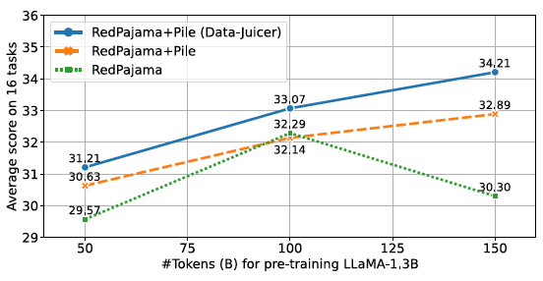
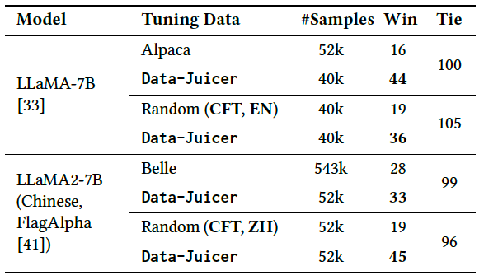
Recipe Usefulness
Pretrain Performance of refined datasets
Consistently better performance
Refined datasets > Original datasets
SFT Performance of refined datasets
English model:
Less than 4/5 samples → 17.5% higher winning rate
Chinese model:
Less than 1/10 samples → slightly higher winning rate
Notes:
Then we evaluate the usefulness of these recipes and refined datasets by them.
For pretrain datasets, we compared the performance of pretrained models trained on the refined datasets and the original datasets respectively.
As the figure shows, the model trained on the refined datasets shows better performance.
For SFT datasets, we trained two models in English and Chinese. And for both models, they achieve higher winning rate with less training data from refined datasets.

Slide 15
Data-Juicer: System Optimization
OP Fusion
Avoid redundant computation
Distributed Processing
Systematic scalability
Notes:
The efficiency is important to a data processing system. So we made several optimizations to the entire system.

Slide 16
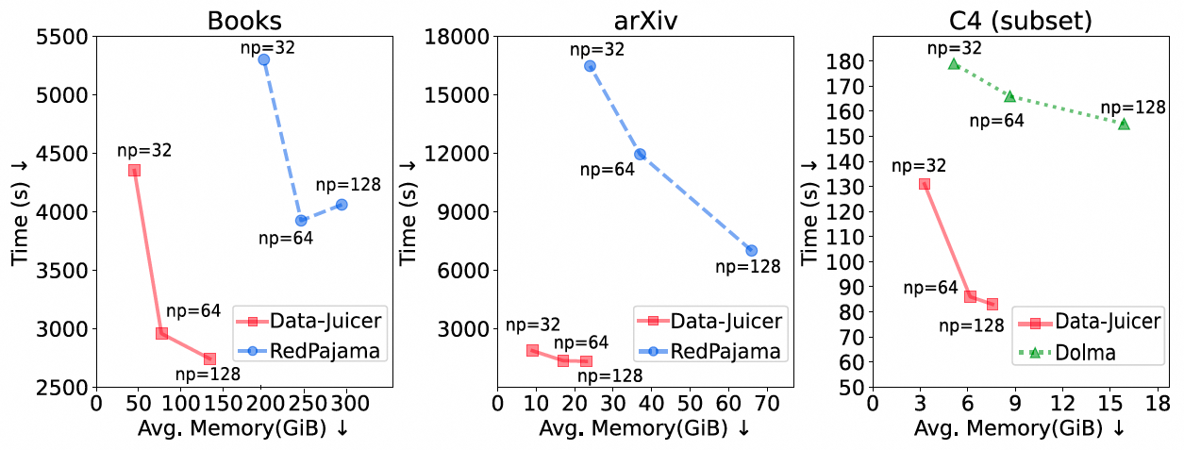
System Optimization
Resource consuming comparison of data processing
Baseline：Dolma & RedPajama
Avg. Time (↓50.6%)
Avg. Memory (↓55.1%)
The basic implementation is already efficient!
Notes:
We focus on the resource consuming of the data processing pipelines.
We select two well-known and popular data processing pipelines, Dolma from Allen.ai and RedPajama from Together.ai, as the baselines. And we compared Data-Juicer with them on both time consumption and memory occupation.
As the figures show, Data-Juicer only need about half the processing time and memory.
Therefore, the basic implementation of Data-Juicer is already efficient!

Slide 17
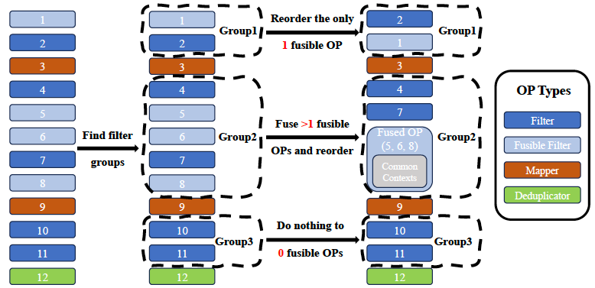
System Optimization: OP Fusion
Opt 1: OP Fusion + Context Management + OP Reordering
Core facts:
Some OPs share the same contexts and computation sub-procedures
Filters are commutative
Fused OPs are time-consuming
Steps：
Detect OP groups
Identify fusible OPs
OP fusion
Reorder OPs
Notes:
Furthermore, we made optimizations of OP fusion, context management and OP reordering.
The core idea comes from three aspects. First, there are some OPs sharing the same contexts and sub-procedure. For example, both counting the number of words and computing the word repetition ratio need to split words. Second, Filters are commutative, which means if we exchange two successive filters, the processed results keep the same. Third, the fused OPs are usually more time-consuming.
So we only need to detect successive Filters group, identify and fuse those fusible OPs, and put the fused OPs to the last of the group.
Customized OPs from users can be fused as well according to our developer guidance.

Slide 18
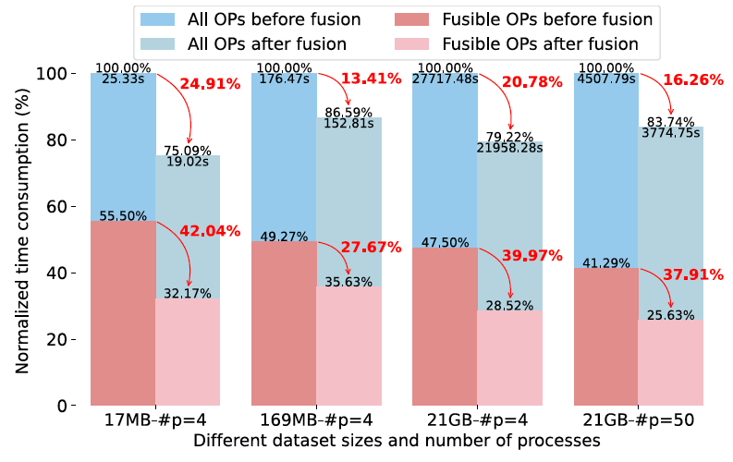
System Optimization: OP Fusion
Opt 1: OP Fusion + Context Management + OP Reordering
End-2-end performance comparison
14 OPs (5 Fusible OPs)
Notes:
We evaluate the end-to-end processing performance and compared the time consumption before and after OP fusion on different sizes of datasets and number of processes. We select 14 OPs in the recipe and five of them are fusible. As the figure shows, OP fusion saves lots of processing time.

Slide 19
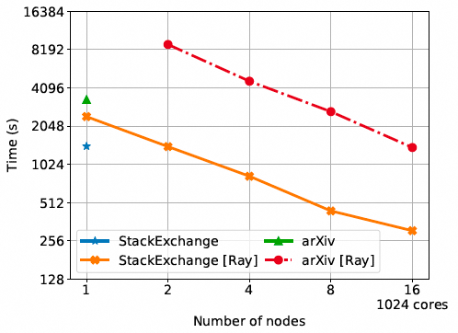
System Optimization: Parallelization
Opt 2: Parallel Processing
Multi-core multi-node
Based on Ray
Systematic scalability
Notes:
The second optimization is that Data-Juicer supports data processing in parallel. It supports ray based multi-core and multi-node distributed processing, and the experiments show that Data-Juicer is systematically scalable.

Slide 20
System Optimization: Parallelization
Opt 2: Parallel Processing
Utilize CUDA for model-based OPs
On-cloud distributed processing:
Alibaba Cloud PAI-Designer
Alibaba Cloud PAI-DLC/DSW
Notes:
Furthermore, some OPs are model-based. Data-Juicer makes use of CUDA to speed up these OPs. Data-Juicer also supports on-cloud distributed processing on several Alibaba Cloud products, including PAI-Designer, DLC and DSW.

Slide 21
Data-Juicer: Feedback Loop
Return multiple feedback signals
Refine datasets systematically
Notes:
How do we get our own high-quality data with all above in general? We can put datasets into a feedback loop to generate refined datasets with the returned feedback signals systematically.

Slide 22
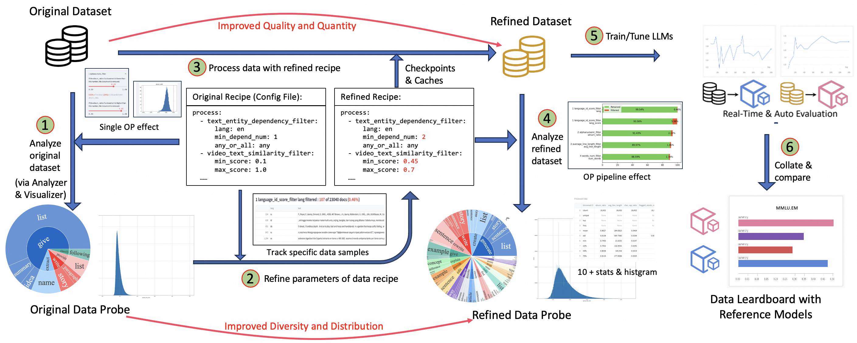
Data-Juicer: Feedback Loop
Improve data quality with feedbacks from different steps of data-model co-development
The whole loop has been formed as a Data-Model SandBox in Data-Juicer now!
Notes:
Feedback loop is used to improve the data quality with feedbacks from different steps of data-model co-development.
These feedback signals can come from the analysis results of the original datasets or the refined datasets. They reflect the diversity and quality information of these datasets.
After training and evaluating a model with refined datasets, the evaluation results can be a feedback signal as well to indicate the actual performance of the refined datasets.
These feedback signal from different stages can be used to refine the data recipes and the datasets to get higher-quality, juicier, and more digestible datasets for LLMs.
Now, this whole loop has been formed as the Data-Model SandBox in Data-Juicer, so users can run this loop easily and automatically.

Slide 23







Data-Juicer: Beyond the Paper
From Text to Multimodal
Modalities: images, audios, videos, ……
Datasets: MMC4, WavCaps, MSR-VTT, ……
MLLMs: LLaVA-like, Sora-like……
More details in our oncoming tutorial
Data-Juicer Competitions
(Historical) FT-Data Ranker, Better Mixture
(In progress) ModelScope-SORA
Under continuous maintenance, enhancement; welcome to join the community!
Notes:
We’re honored that this work was accepted by SIGMOD 2024 months ago. After that, we continue to enhance Data-Juicer beyond the paper.
First of all, Data-Juicer is extended from text-only to multimodal data processing. Now it supports more modalities. Datasets in different modality can be converted and refined by Data-Juicer, and they can be easily used in multimodal models. More details about this part will be included in our oncoming tutorial on KDD 2024.
In addition, Data-Juicer had hosted two historical competitions on Alibaba Tianchi Platform about data development for LLMs. Our latest competition is in progress, which is about how to produce high-quality video datasets for Sora-like models. Welcome everyone to follow and participate in this competition!
Finally, Data-Juicer is open-source and under continuous maintenance and enhancement by our team and community. Welcome to join the Data-Juicer community!

Slide 24
Thanks
Q & A
GitHub: https://github.com/modelscope/data-juicer
Notes:
That’s all. Thanks for your listening!

